Slide 1


Slide 2
What is github?
At a high level, GitHub is a website and cloud-based service that helps developers store and manage their code, as well as track and control changes to their code. To understand exactly what GitHub is, you need to know two connected principles:
Version control
Git

Slide 3
What is a Version control system?
A version control system, or VCS, tracks the history of changes as people and teams collaborate on projects together. As the project evolves, teams can run tests, fix bugs, and contribute new code with the confidence that any version can be recovered at any time. Developers can review project history to find out:
Which changes were made?
Who made the changes?
When were the changes made?
Why were changes needed?

Slide 4
What is git?
Git is a free, open-source version control software. It was created by Linus Torvalds in 2005. This tool is a version control system that was initially developed to work with several developers on the Linux kernel.
Git is an example of a distributed version control system (DVCS) commonly used for open source and commercial software development. DVCSs allow full access to every file, branch, and iteration of a project, and allows every user access to a full and self-contained history of all changes. Unlike once popular centralized version control systems, DVCSs like Git don’t need a constant connection to a central repository. Developers can work anywhere and collaborate asynchronously from any time zone.

Slide 5
What is the difference?
Git
github
git is a local VCS software that enables developers to save snapshots of their projects over time. It’s generally best for individual use.
Your GIT repositories are generally saved on your workstation
GitHub is a web-based platform that incorporates git’s version control features so they can be used collaboratively. It also includes project and team management features, as well as opportunities for networking and social coding.
You GIT repositories are saved to the cloud

Slide 6
github
Makes it a lot easier for individuals and teams to use Git for version control and collaboration
It’s interface is user-friendly enough so even novice coders can take advantage of Git
Without GitHub, using Git generally requires a bit more technical savvy and use of the command line
GitHub is so user-friendly, though, that some people even use GitHub to manage other types of projects – like writing books
Anyone can sign up and host a public code repository for free, which makes GitHub especially popular with open-source projects.

Slide 7
Installing Git
installation
Update git
https://git-scm.com/downloads
Select your OS version
Linux or Mac – follow the terminal instructions
Windows download the .exe and install the program
git clone https://github.com/git/git

Slide 8

Registering a github account
Register
Tips
https://github.com/
Enter your Username, preferred email address, and chose a password
Click:
Use a professional Username as it will not only be included on your profile but also in each repository's URL
Do not forget which email you used to register as this will be your login

Slide 9
How does it all work?
Git and GitHub are separate entities, they can both work independently or they can work together – most developers use them in concert
Git works through terminal commands or through almost every modern IDE
GitHub works through terminal commands as well and most modern IDEs have a built in link or available plug-in

Slide 10
How git works
At a high level, git can be thought of as a database/filesystem/backing store that remembers a truckload of details about your code base. This information is called the git repository, and contains three types of content: blobs, trees and commits.

Slide 11
Git internals
Blob
tree
commit
It is essentially a “file” in git. Each blob is indexed by a SHA1 hash or checksum, so if the same file appears twice in your directory, it will resolve to the same blob in git. And for the record, git assumes that there will never be a hash collision.
Blobs are normally referenced by their hash, although you will rarely need to type these hashes in.
Git uses trees to store directories. Each tree contains a list of entries, which are either blobs (files) or other trees (sub-directories). Like blobs, trees are stored by their hashes. This is a significant detail.... because a single change to a single file (say in root/sub/myfile.txt) will cause myfile.txt’s hash to change, which will cause sub’s content list to change, which will cause root’s content list to change, which will cause root’s hash to change. Thus, the hash of a tree represents the entire state of every single file in that tree.
The next object is the commit, which is a snapshot of a tree along with some additional metadata. As discussed above, the tree reference represents the entire state of every single file in the tree. The metadata provides more context for the commit, including the author, comments, and one or more parents of the commit. Like everything else we’ve seen, commits are referenced by their hashes.
Git supports two types of tags: lightweight and annotated. A lightweight tag is very much like a branch that doesn’t change — it’s just a pointer to a specific commit.
Annotated tags, however, are stored as full objects in the Git database. They’re checksummed; contain the tagger name, email, and date; have a tagging message; and can be signed and verified with GNU Privacy Guard (GPG). It’s generally recommended that you create annotated tags so you can have all this information; but if you want a temporary tag or for some reason don’t want to keep the other information, lightweight tags are available too.
Tag
Notes:
GIT contains 4 types of objects

Slide 12
Git internals
Git maintains a set of refs, which are human readable names that resolve to specific commits. For example, the HEAD ref points to the most recent commit in your currently checked out branch. When you check in another commit, the HEAD ref gets “auto-promoted” to point to your new commit. Most git operations use the HEAD as their default target. Refs are also used to identify your own branches, and the current branch is updated to the latest commit each time you commit, too. As you work, git maintains three different “views” of your filesystem. Simultaneously. For some, this is a source of confusion ;) As you work, a single file (readme.txt) might be in all three locations, and might be different in each location.

Slide 13
Local git operations
Working Directory
Staging Area
Git Directory
(Project)
Checkout the Project
Stage Files
Commit
Notes:
The git repository is the commit (and corresponding tree) that you last checked out.
Any changes you make to files on your disk are reflected in the “working directory”.
You can promote these local changes into the staging area (using “git add”) as often as you like.
Then you commit all of your staged files to the repository.

Slide 14
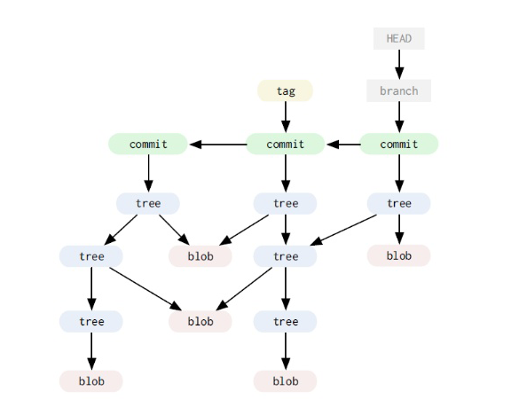
Git internals
When you’re using git, you don’t normally think of blobs or trees. Instead, user-facing commands deal with commits and refs, and most of the work you do in git involves traversing the Directed Acyclic Graph (DAG) of commits in your repository, or adding new nodes into that DAG. The DAG always starts with the “empty” tree, so if you want to think of this in terms of pointers, that would be the null pointer.
Notes:
The image is an example of a Git DAG

Slide 15
What is a git project / repository?
A repository, or Git project, encompasses the entire collection of files and folders associated with a project, along with each file’s revision history. The file history appears as snapshots in time called commits, and the commits exist as a linked-list relationship, and can be organized into multiple lines of development called branches. Because Git is a DVCS, repositories are self-contained units and anyone who owns a copy of the repository can access the entire codebase and its history. Using the command line or other ease-of-use interfaces, a git repository also allows for: interaction with the history, cloning, creating branches, committing, merging, comparing changes across versions of code, and more.
Working in repositories keeps development projects organized and protected. Developers are encouraged to fix bugs, or create fresh features, without fear of derailing mainline development efforts. Git facilitates this through the use of topic branches: lightweight pointers to commits in history that can be easily created and deprecated when no longer needed.

Slide 16
Git terminal commands
Git Basics
git init <directory> | Create empty Git repo in specified directory. Run with no arguments to initialize the current directory as a git repository.
git clone <repo> | Clone repo located at <repo> onto local machine. Original repo can be located on the local filesystem or on a remote machine via HTTP or SSH.
git config user.name <name> | Define author name to be used for all commits in current repo. Devs commonly use --global flag to set config options for current user.
git add <directory> | Stage all changes in <directory> for the next commit. Replace <directory> with a <file> to change a specific file.
git commit -m "<message>" | Commit the staged snapshot, but instead of launching a text editor, use <message> as the commit message.
git status | List which files are staged, unstaged, and untracked.
git log | Display the entire commit history using the default format. For customization see additional options.
git diff | Show unstaged changes between your index and working directory.

Slide 17
Let’s move to github for some hands-on!
https://github.com/TAMUSA-ACM/Git-GitHub-Workshop

Slide 18
Does it work with my ide?

Slide 19
How to use git + github with your ide
IDE | Git | GitHub
Visual Studio Code | X | X
Atom | X | X
Eclipse | X | X
NetBeans | X | X
IntelliJ | X | X
PyCharm | X | X
Android Studio | X | X
Xcode | X | X

Slide 20
README Files

Slide 21
What is a readme file?
A README is a text file that introduces and explains a project
It contains information that is commonly required to understand what the project is about
It is an easy way to answer questions that your audience will likely have regarding how to install and use your project and also how to collaborate with you
You might want to get into the habit of making it the first file you create in a new project

Slide 22
“[README files] can almost be more valuable than a resume, since the developer is describing the problem they’re trying to solve with their code.”
- Robert Fleischhauer, senior technology recruiter with the InSource Group in Dallas

Slide 23
Questions to answer
What does your project do?
How is it set up?
How is it used?
Is it in good shape?
How can others help?
License information…

Slide 24
The Profile page

Slide 25
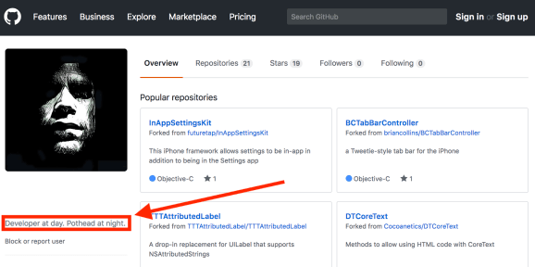

Slide 26
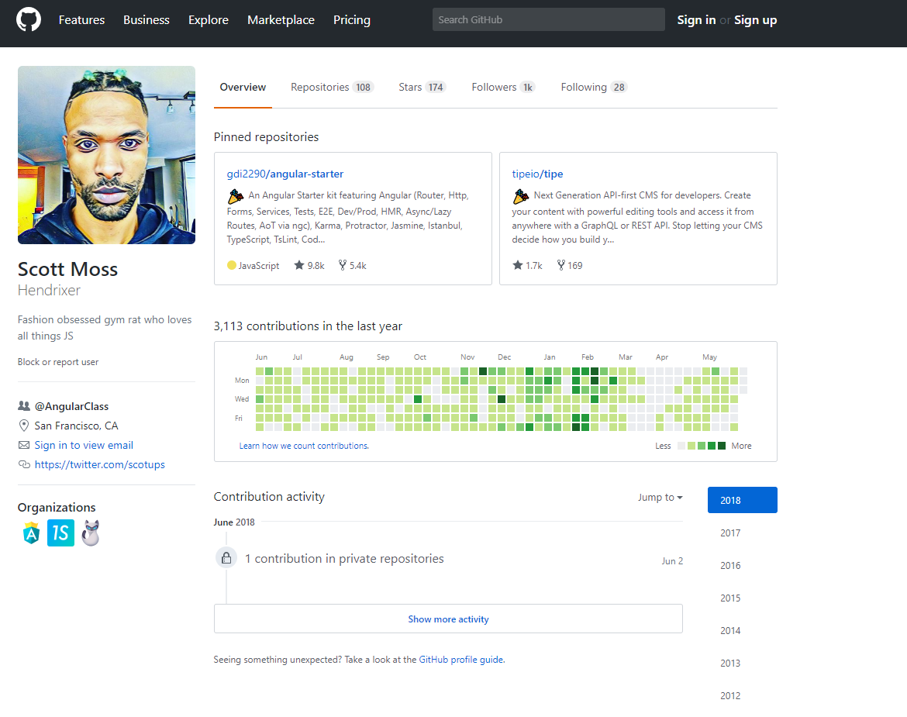
Contribution chart
This is one of the first things a hiring manager is going to look at.
Each square is a day. The darkness of the green indicates how many contributions were made on that day.
You can see that Scott is very active, making at least one contribution most days.
It’s pretty clear he spends a lot of time working with code.
A good sign to a recruiter.
The heat map with the activity gives a really good sense if people are passionate about coding.
Profile Photo
A picture with a friendly smile can help recruiters make a connection with you but it isn’t mandatory.
If you’re not using a picture of yourself be sure to include a picture that somehow captures your personality. But nothing crude.
Repositories
The descriptions are nice so that we know what these repositories are for.
He has an impressive list of contributions to repositories. This is a clear indication that he is involved in collaborating with others on open source software.
Employers can look through Scott’s contributions to judge how well he works on a team.

Slide 27
Questions?

